Slide 1
Exploring Language Grounding for Few-Shot Learning in
3D Medical Segmentation
Mohammadreza Dorkhah, Yide Ma

Slide 2
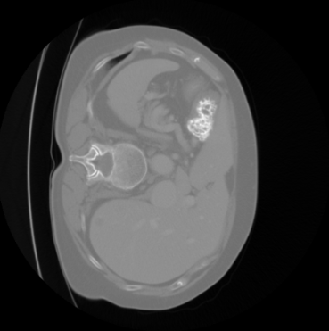
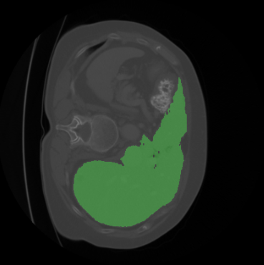
Problem Statement - Goal
Our task is to perform organ segmentation on medical images, using a combination of the image data and natural language instructions as input.
“Liver”
Notes:
So our goal is to not only input 3d scans to get 3d scans, we also input the text we want to segment and have segmented output. Basically we are the first one to add language grounding in 3d medical segmentation tasks.

Slide 3
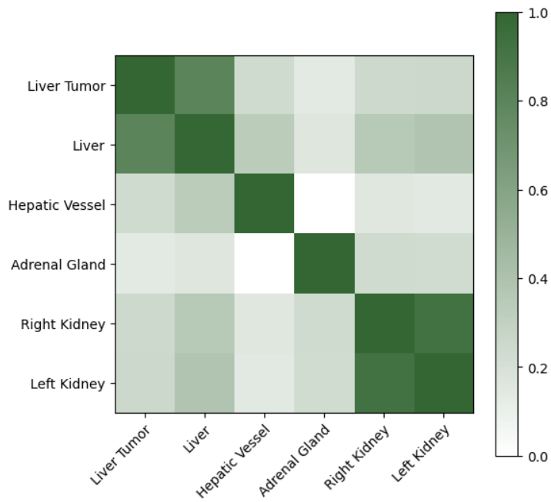
Problem Statement - Motivation
The adrenal glands are located on top of the kidneys and produce hormones that are important for kidney function.
The hepatic vessels supply oxygenated blood to the liver.
Notes:
The similarity of liver and liver tumor is very obvious. Similarity of left and right kidneys. Maybe similarity come from common word. Hepatic vessel is more close to liver rather that kidneys. We know hepatic vessel supplies oxigenated blood to the liver. Adrenal glands that located on top of kidneys are closer to kidneys rather than liver. clip embeddings shows some semantic relations between the organs. Semantic relationship can be used to enhance segmentation. Also let the model to segment new class.

Slide 4
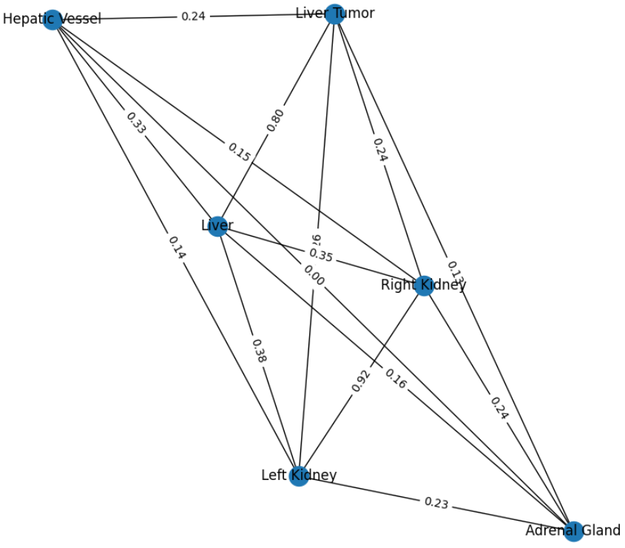
Problem Statement - Motivation
Leveraging the semantic relationship between abdominal structures will enhance the precision of the segmentation.
Incorporating text embedding input into the segmentation models will enable us to segment new classes.

Slide 5
Problem Statement - Input / Output
Inputs: a medical image and an instruction text.
The medical image is .nii files, which contains the 3D CT scans of the patient's internal organs.
The instruction text is a natural language sentence or a phrase that describes the target organs to be segmented in the image.
Output: a segmented image, in which the pixels corresponding to each target organ are assigned a unique label.
Our model can handle multiple instruction texts for the same medical image and can segment different organs at the same time.

Slide 6
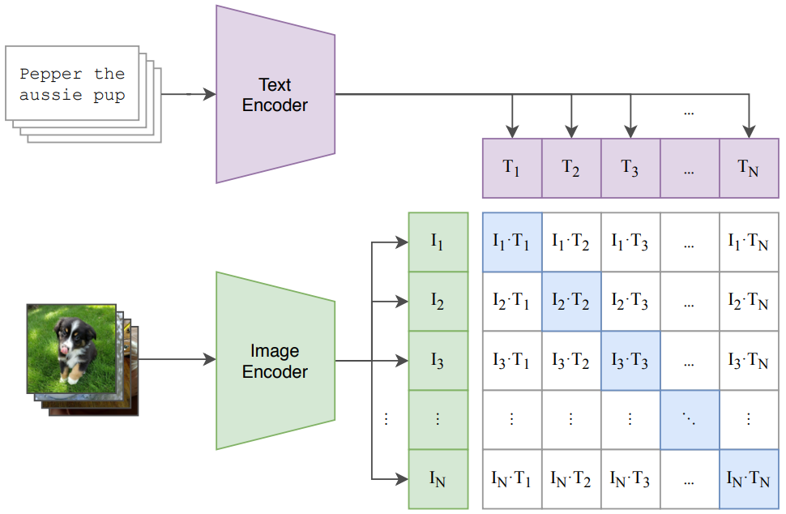
Related Work - CLIP
CLIP (Contrastive Language-Image Pre-Training) is a neural network model developed by OpenAI that is capable of understanding natural language and processing images.
It is based on a transformer architecture and is pre-trained on a massive dataset of images and corresponding captions.
"Learning Transferable Visual Models From Natural Language Supervision" by Radford et al. (2021), arXiv:2103.00020

Slide 7
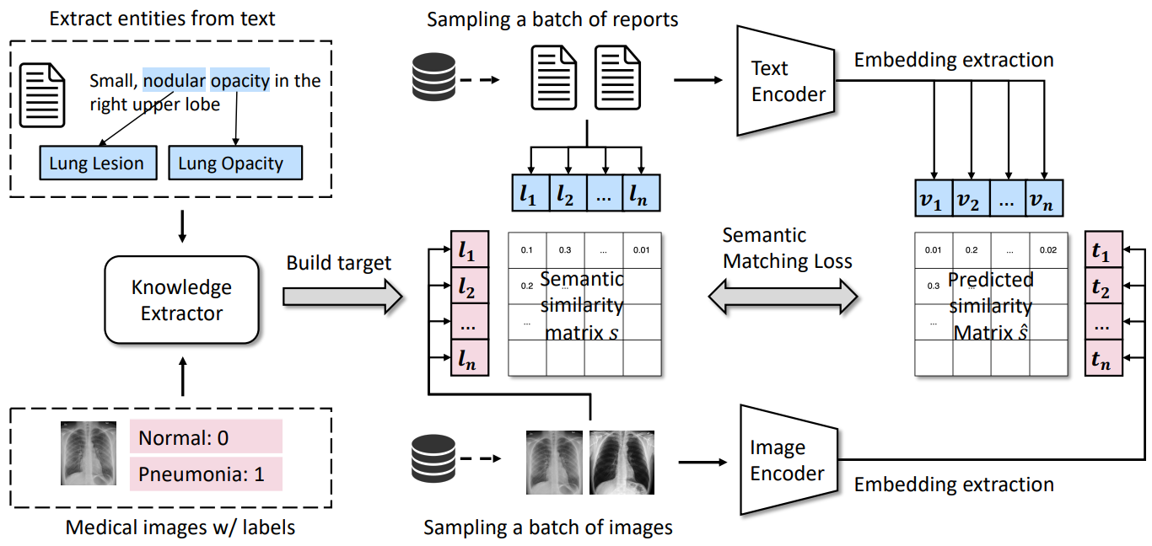
Related Work - MedCLIP
MedCLIP is a large-scale CLIP-based model trained on a dataset of medical images and text.
The MedCLIP that we used is trained on around 60,000 pairs of images and corresponding reports from the Radiology Objects in COntext (ROCO) dataset.
“MedCLIP: A Large-Scale Clip-based Model for Medical Image Diagnosis.” by Wang et al. (2021), arXiv:2210.10163

Slide 8
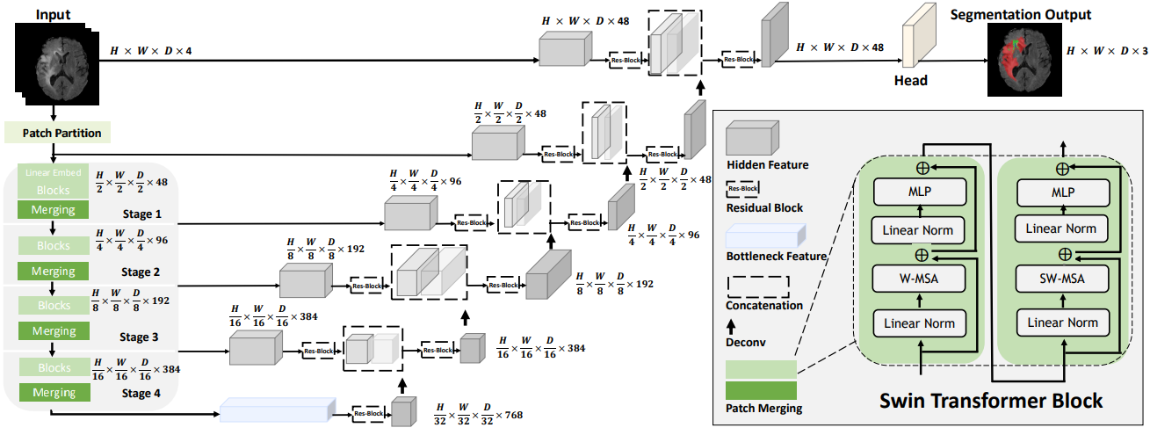
Related Work - SwinUNETR
SwinUnetR is the SOTA deep learning model for semantic segmentation of medical images.
It is a modified version of the Swin Transformer architecture that uses a hybrid receptive field block and residual connections to achieve high accuracy.
"Swin-UnetR: Unet-like Pure Transformer for Medical Image Segmentation" by Liu et al. (2021), arXiv:2201.01266

Slide 9
Input Image
Prediction
Input Text
“Liver”
SwinUnetR Encoder
SwinUnetR Decoder
CLIP/MedCLIP
Text Encoder
Image Feature
Self
Attention
Cross
Attention
Text Embedding
Self
Attention
Cross
Attention

Slide 10
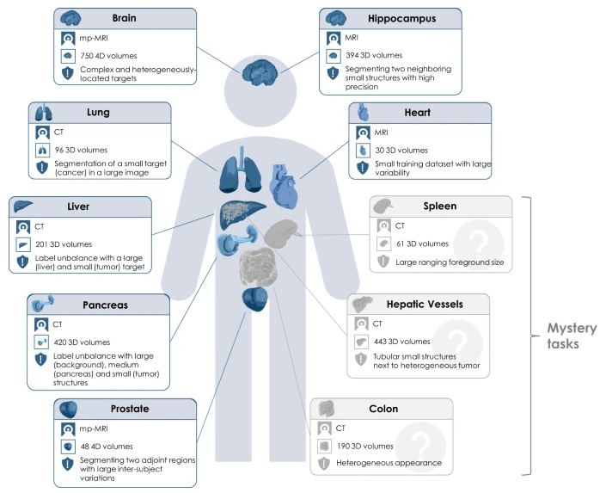
Dataset
The Medical Segmentation Decathlon (MSD) is a benchmark dataset for evaluating and comparing the performance of medical image segmentation algorithms.
It consists of 10 different medical image segmentation tasks covering various anatomical structures, imaging modalities, and pathologies.
The dataset contains 3D and 4D CT scans and MRIs with corresponding manual segmentation masks, split into training, validation, and test sets.

Slide 11
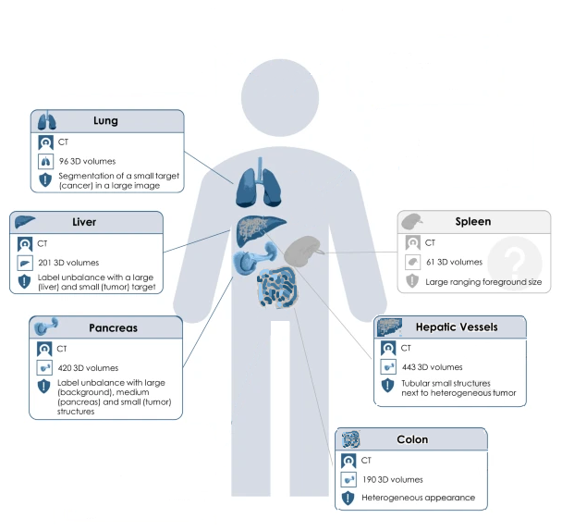
Data
We used only CT (Computed Tomography) images (947 images) belonging to the Liver, Lung, Pancreas, Colon, Hepatic Vessel, and Spleen for training and testing the model.
The Spleen was excluded from the training set and reserved for zero-shot and few-shot experiments.
Unseen

Slide 12
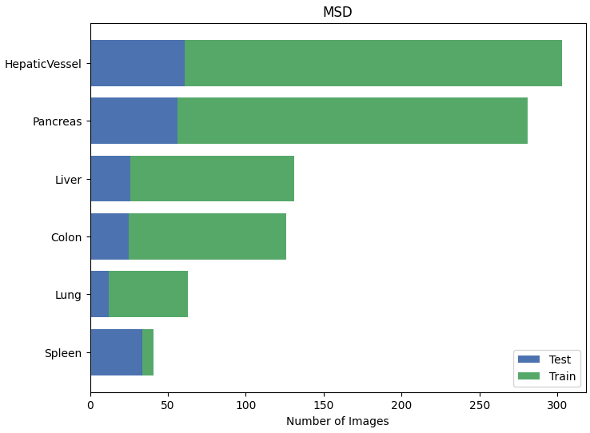
Class Distribution

Slide 13
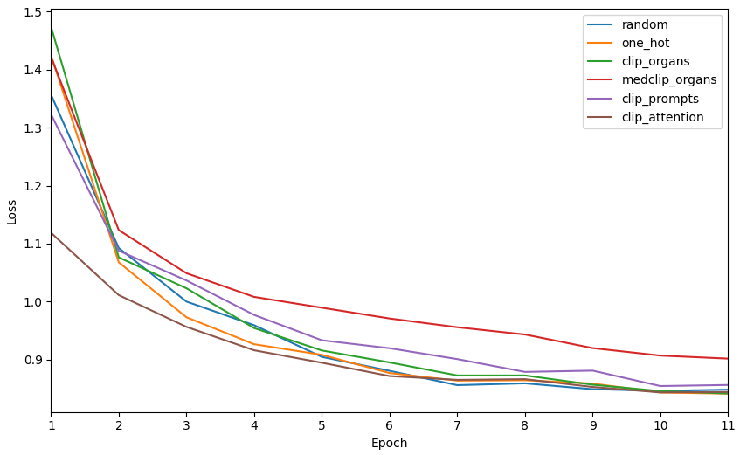
Training
Environment: Google Colab Pro+
GPU: NVIDIA A100 with 40 GB of memory
Batch size: 1
Number of epochs: 11
Optimizer: AdamW
Loss: Cross Entropy
Learning rate: 1e-4
Weight decay: 1e-5
*
* Prompt: “CT scan of the <organ>”

Slide 14
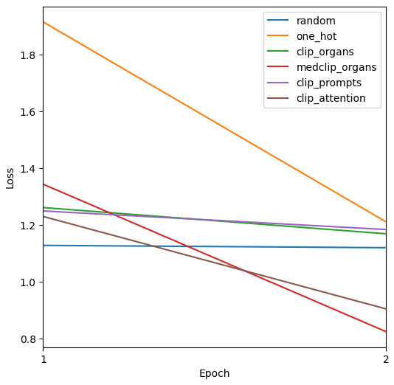
Training
Few-shot training for Spleen class
Four images
Two epochs

Slide 15
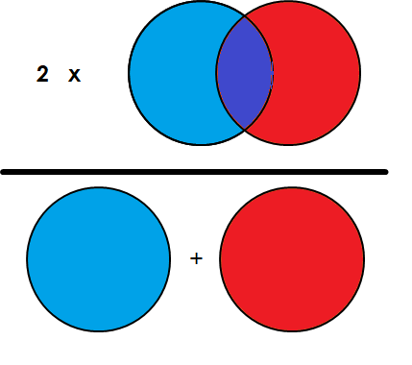
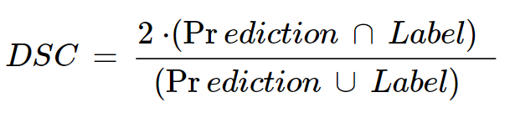
Evaluation
Dice Score: Measure of overlap between two sets of data and ranges from 0 to 1.

Slide 16
Results
 | Liver | Liver Tumor | Lung Tumor | Pancreas | Pancreas Tumor | Hepatic Vessel | Hepatic Vessel Tumor | Colon Tumor | Spleen (few-shot) | Average
Random | 0.9466 | 0.4791 | 0.1186 | 0.7364 | 0.2473 | 0.5348 | 0.4419 | 0.1366 | 0.0000 | 0.4046
One Hot | 0.9435 | 0.4708 | 0.1288 | 0.6936 | 0.1732 | 0.5073 | 0.4267 | 0.0993 | 0.0000 | 0.3826
CLIP Organs | 0.9483 | 0.4436 | 0.1298 | 0.7446 | 0.1422 | 0.5258 | 0.4259 | 0.1000 | 0.0001 | 0.3845
MedCLIP Organs | 0.9148 | 0.3476 | 0.0703 | 0.0199 | 0.1164 | 0.1101 | 0.2457 | 0.1049 | 0.0369 | 0.2185
CLIP Prompts | 0.9382 | 0.4455 | 0.1728 | 0.6079 | 0.1793 | 0.4354 | 0.2958 | 0.1279 | 0.0022 | 0.3561
CLIP Attention | 0.9332 | 0.3554 | 0.0971 | 0.7192 | 0.1605 | 0.4836 | 0.4139 | 0.0968 | 0.4895 | 0.4166

Slide 17
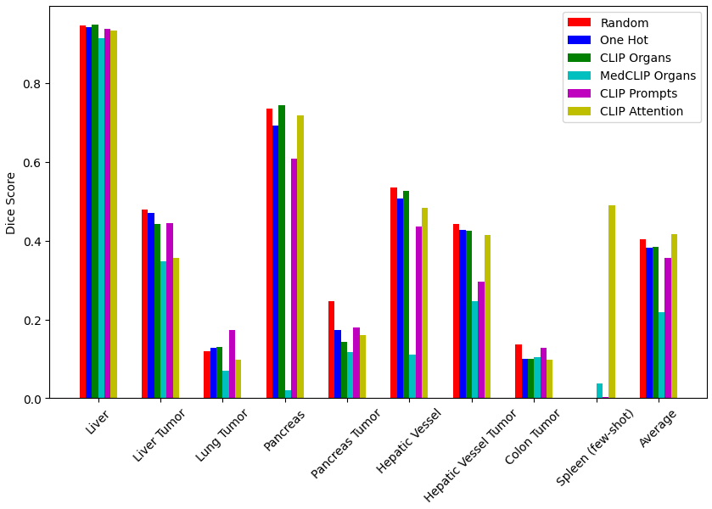
Results

Slide 18
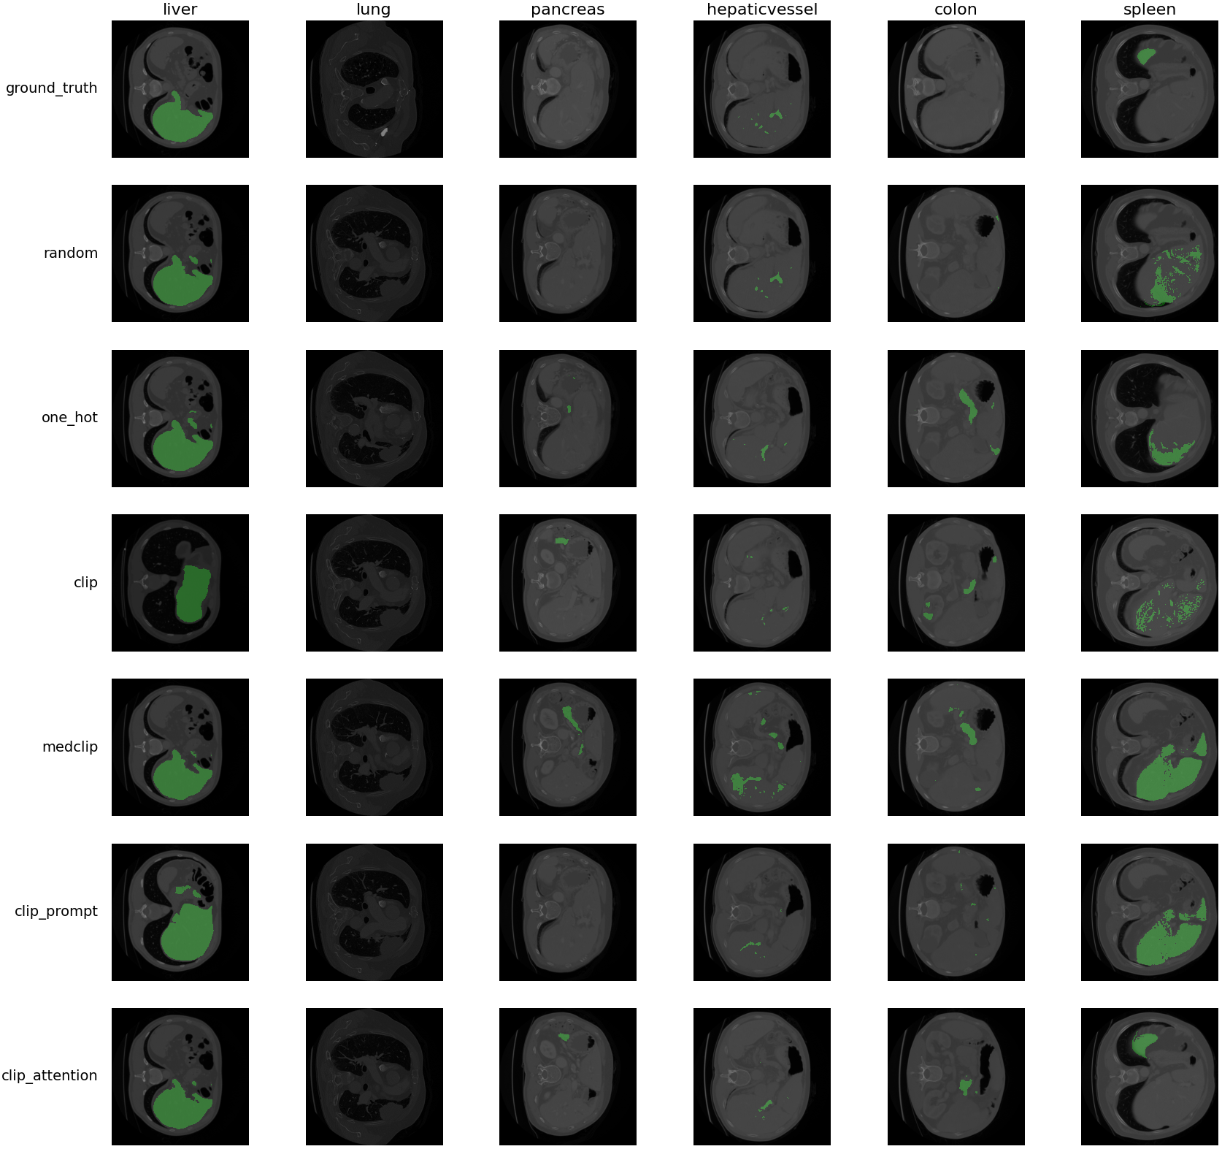
Results

Slide 19
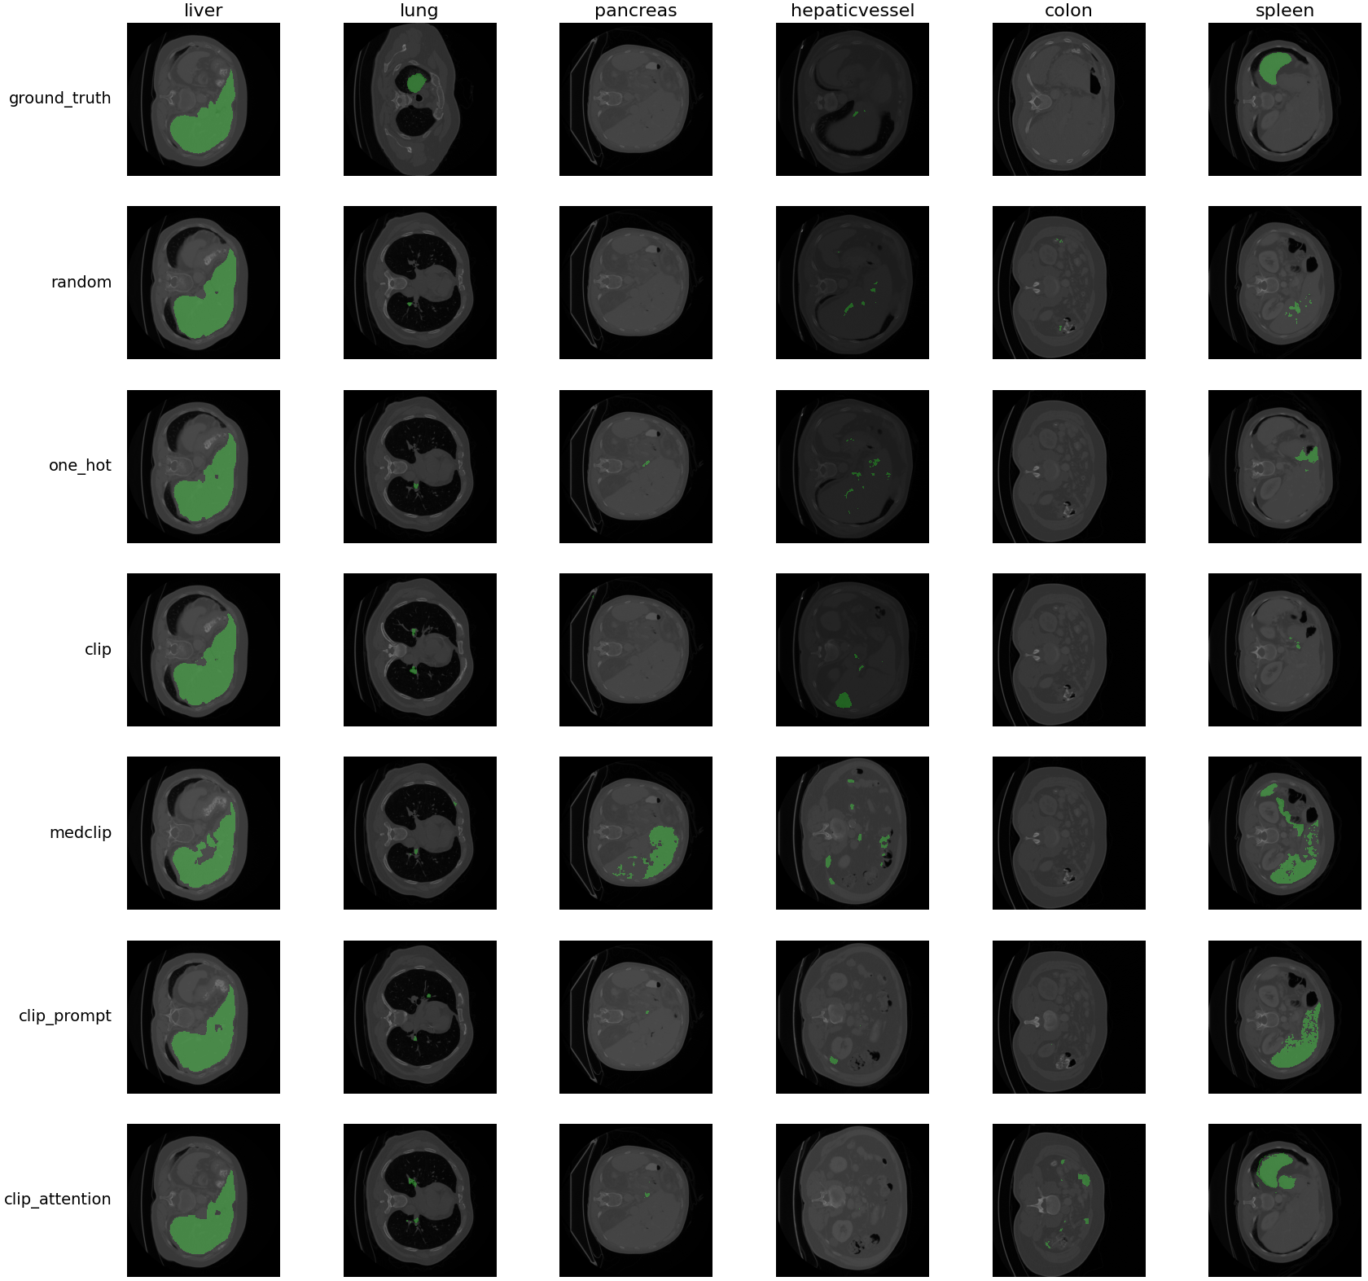
Results

Slide 20
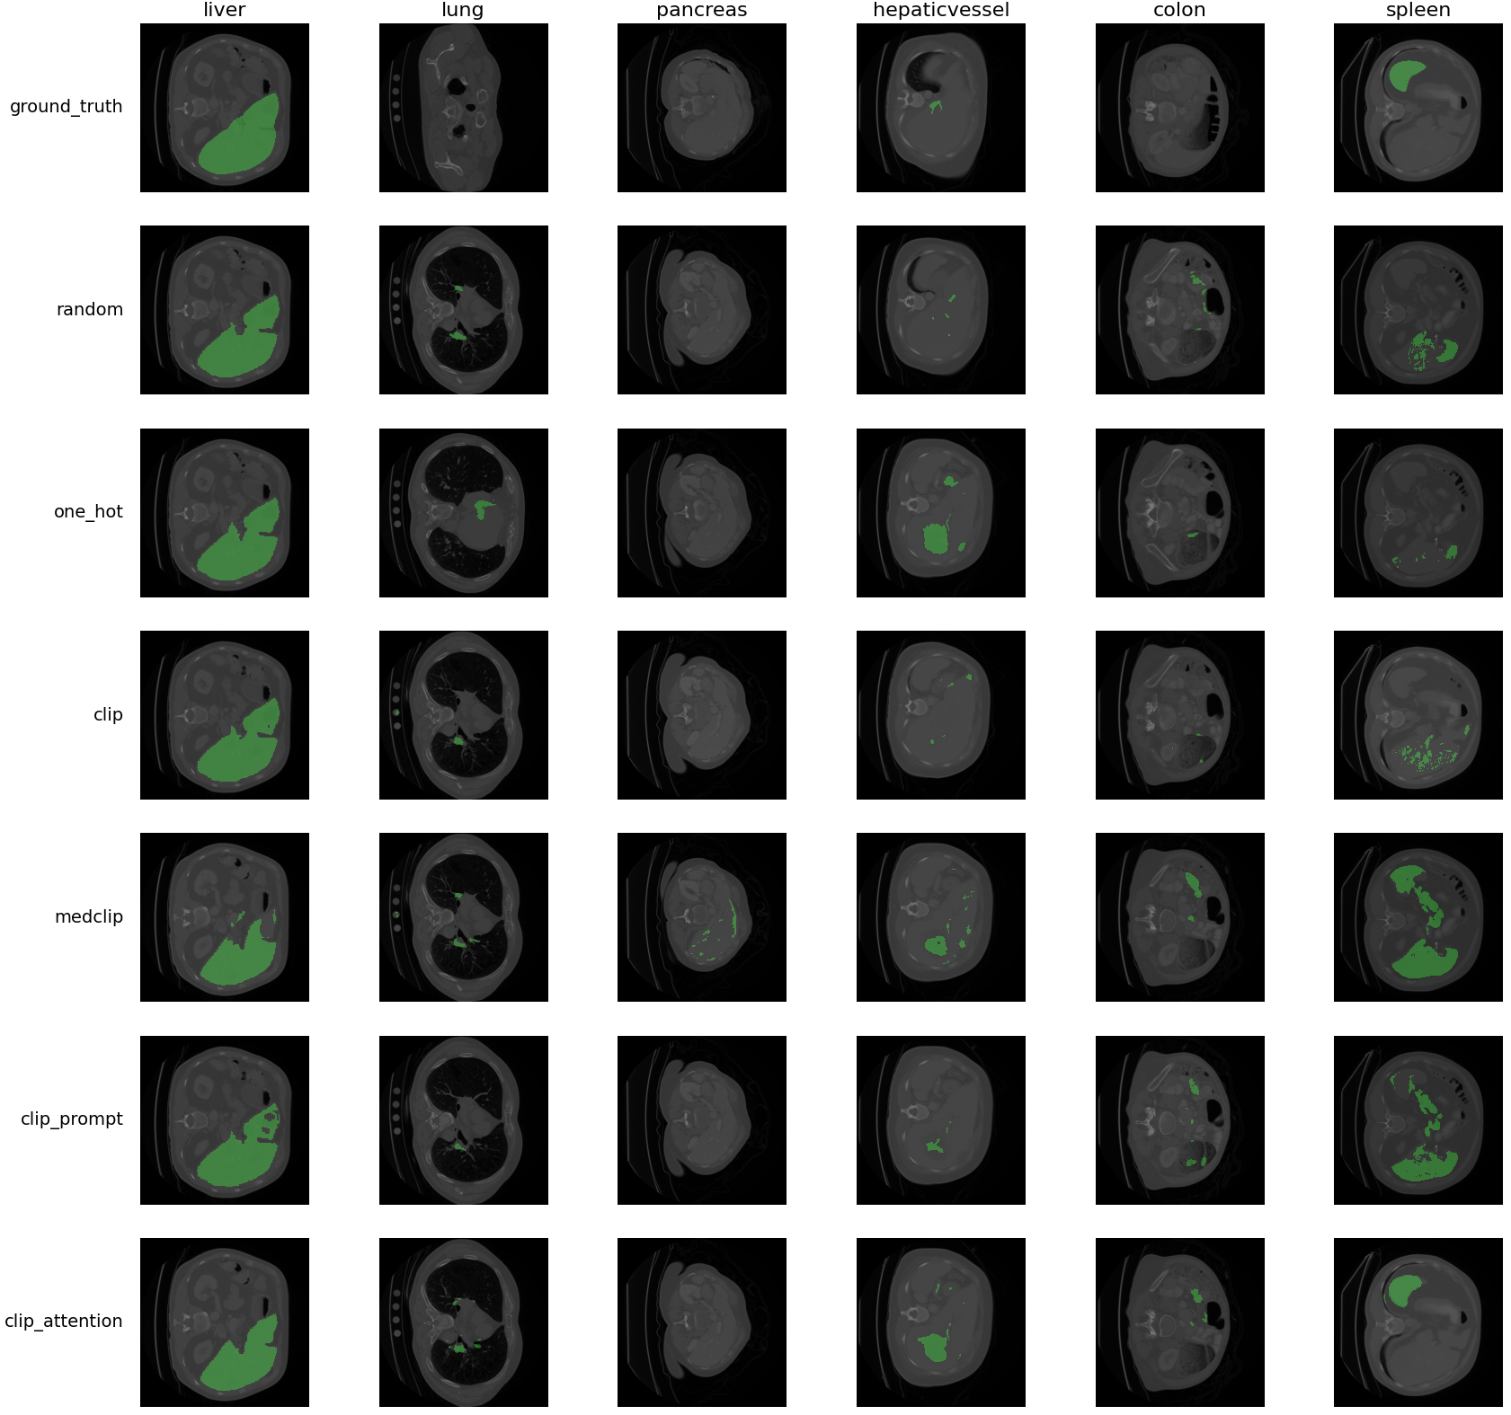
Results

Slide 21
Conclusion - Findings
Using different text embeddings does not necessarily improve segmentation performance.
We observed that the CLIP-based models tend to segment liver when they are asked to segment spleen.
Functionally, the spleen is closely associated with the liver, as they are located adjacent to each other and share some physiological roles, such as filtering the blood and removing harmful substances.
The poor performance of MedCLIP was something unexpected.
Incorporating attention mechanisms with CLIP for multi-modality fusion can enhance few-shot learning.
The approach for converting/extracting features to a shared latent space when fusing different modalities can significantly affect model performance. One possible solution is to eliminate non-essential biases.

Slide 22
Conclusion - Limitations
Computational resources are important factors for improving model performance and doing more experiments, especially with large datasets and complex models. The use of large GPUs is inevitable.
Our experiments are very limited due to limitations in time and resources.
The CLIP is not trained on 3D images, so we can’t expect the same performance.
Adding language grounding is more efficient in localization rather than segmentation.

Slide 23
Conclusion - Future Direction
In the medical field, acquiring data can be prohibitively expensive. Exploring the use of language models to generate realistic data could be a promising future research direction.
Incorporating 3D spatial embeddings could aid in segmentation tasks since human organs are typically stationary.
Developing methods to evaluate zero-shot and few-shot learning approaches for various medical tasks could also be an avenue for future research.

Slide 24
Thank you!

